Slide 1
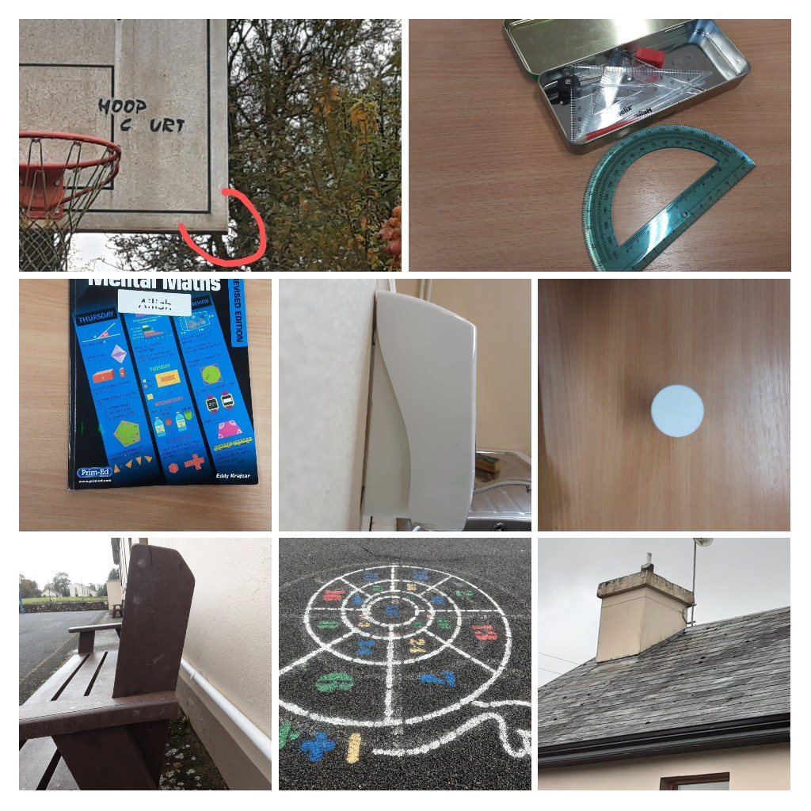
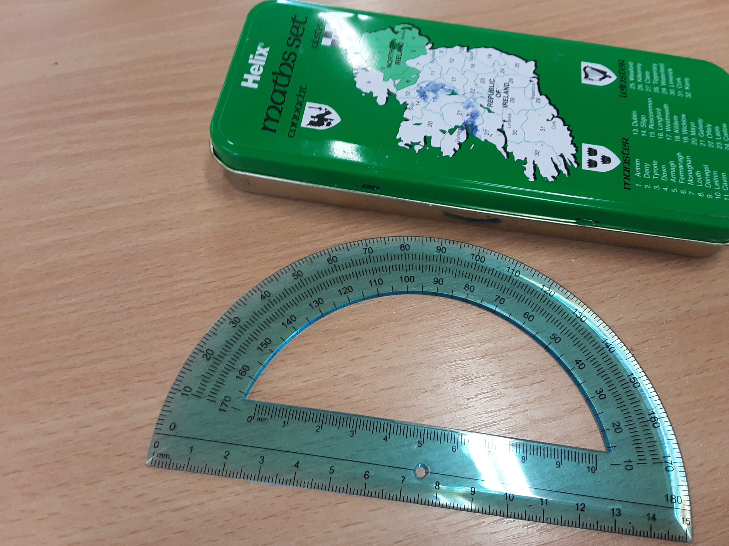
Angles in the environment.
By ailish

Slide 2
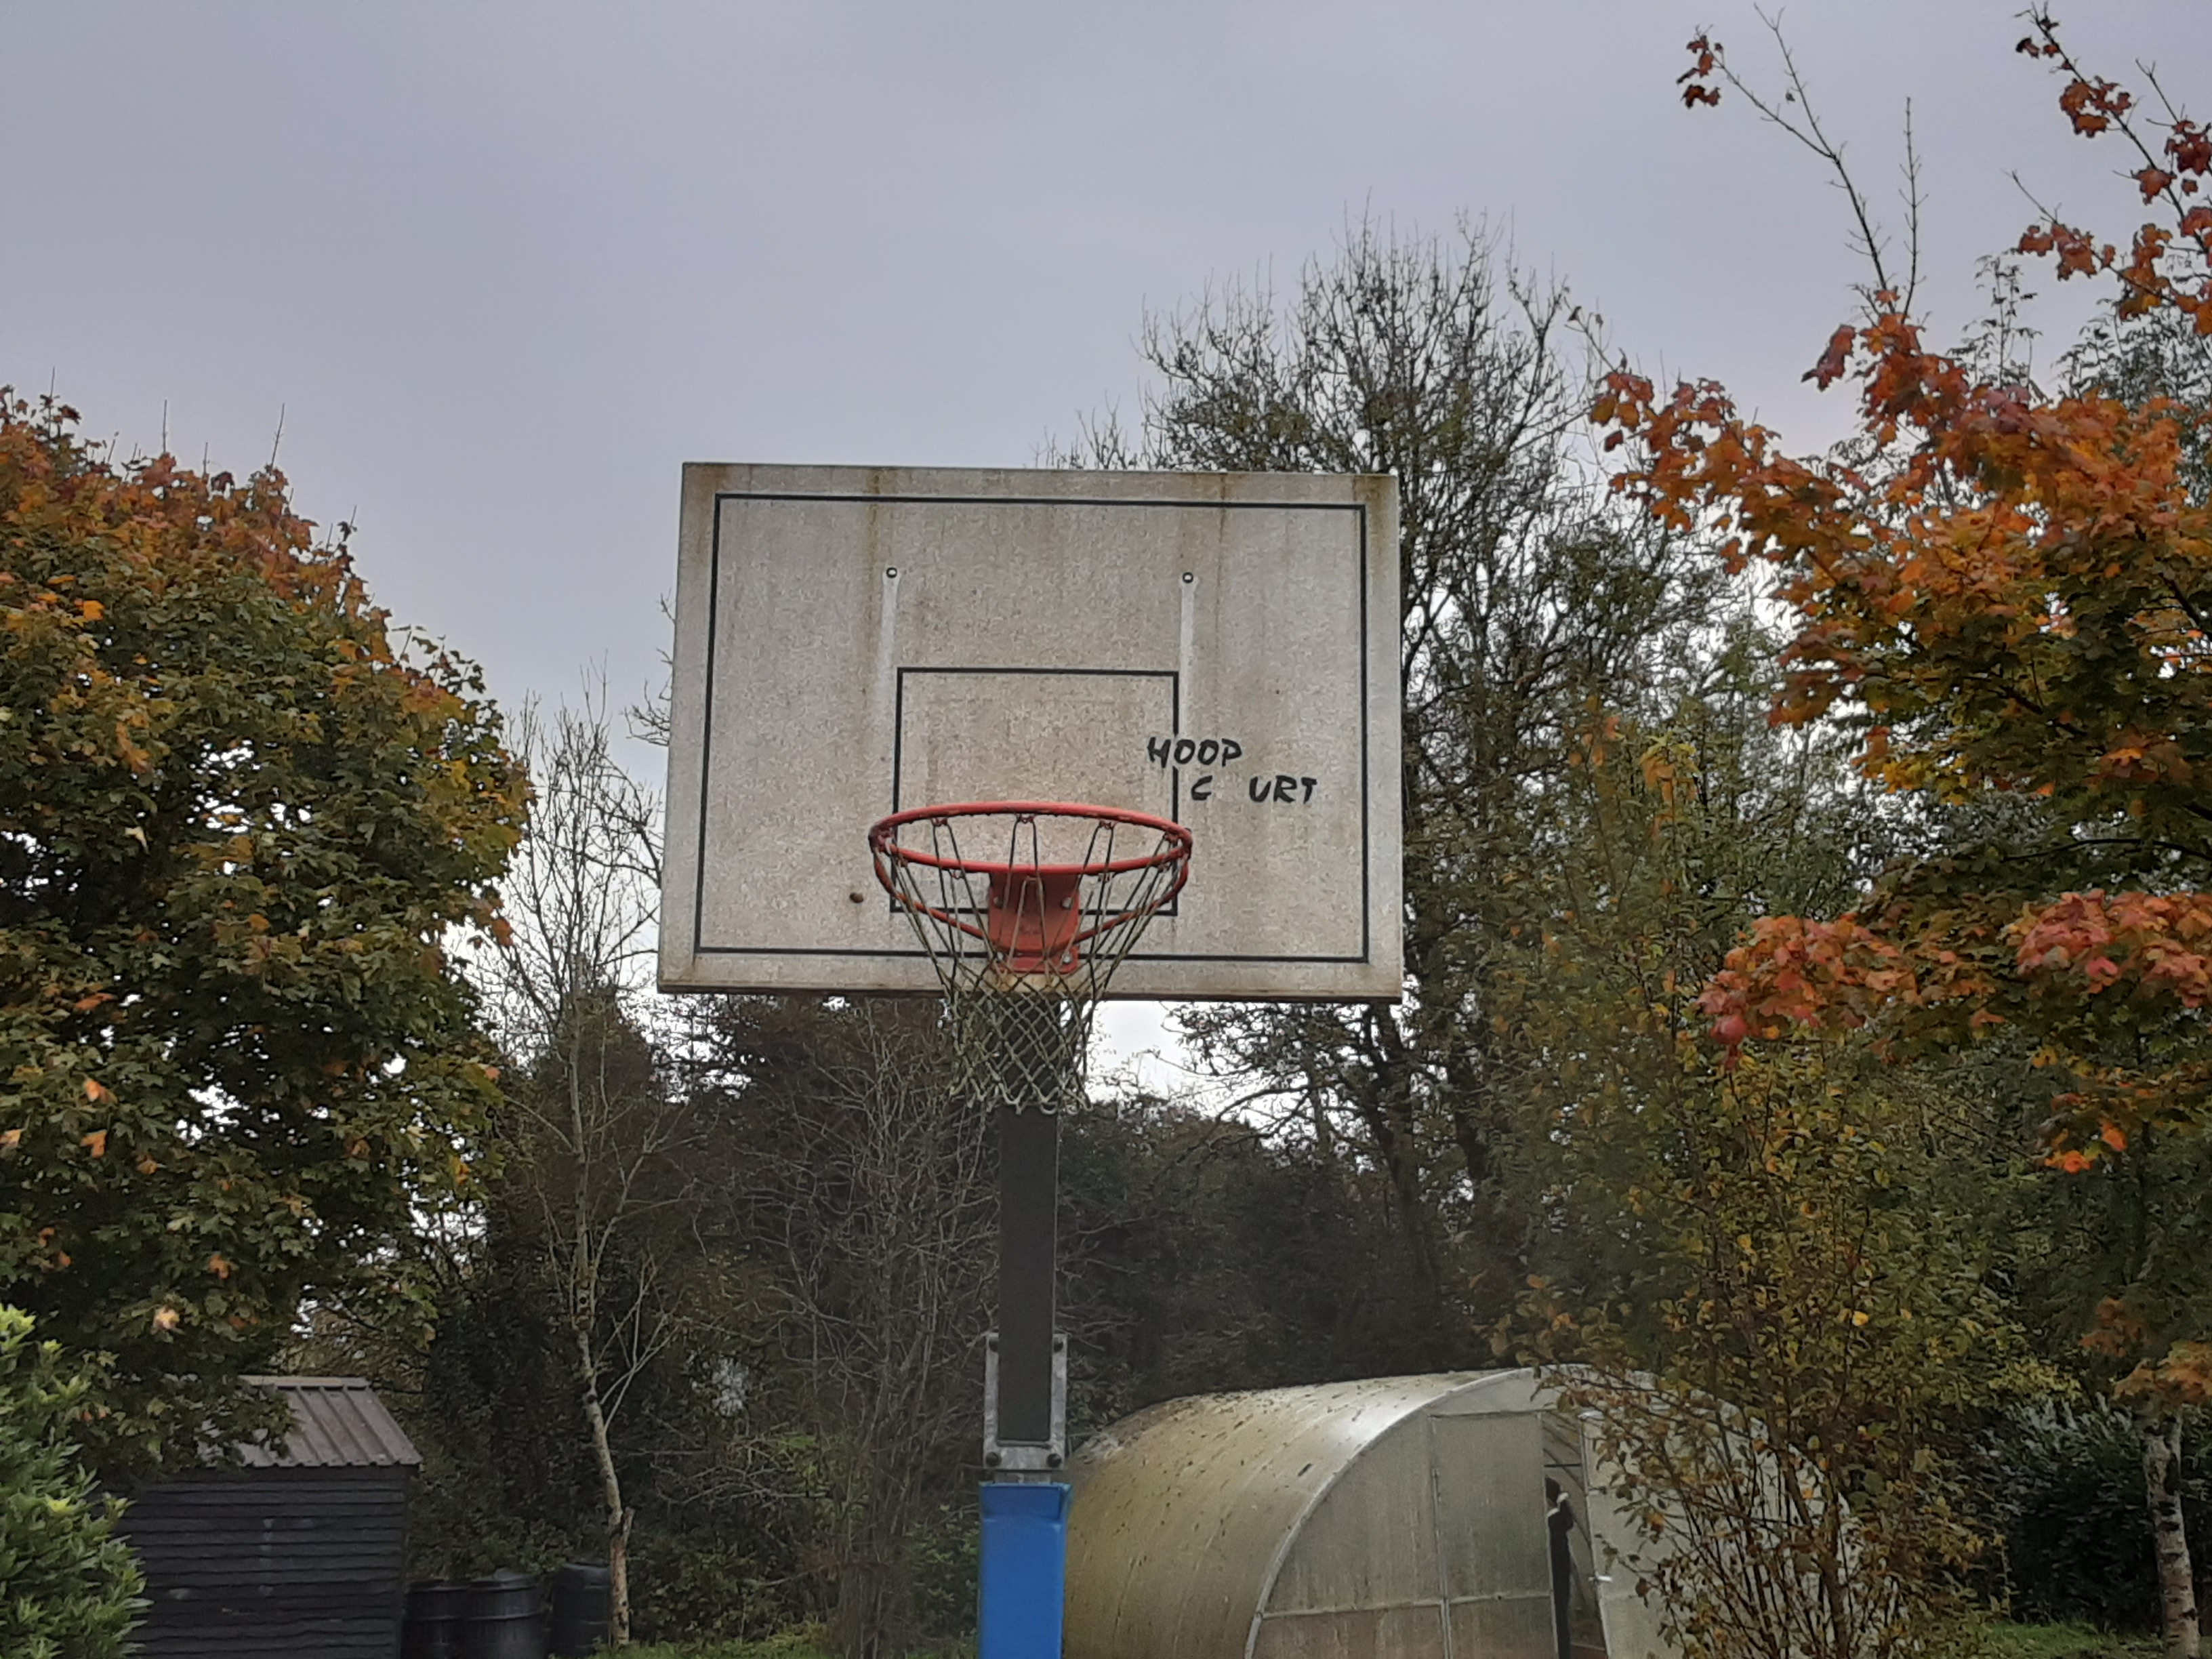
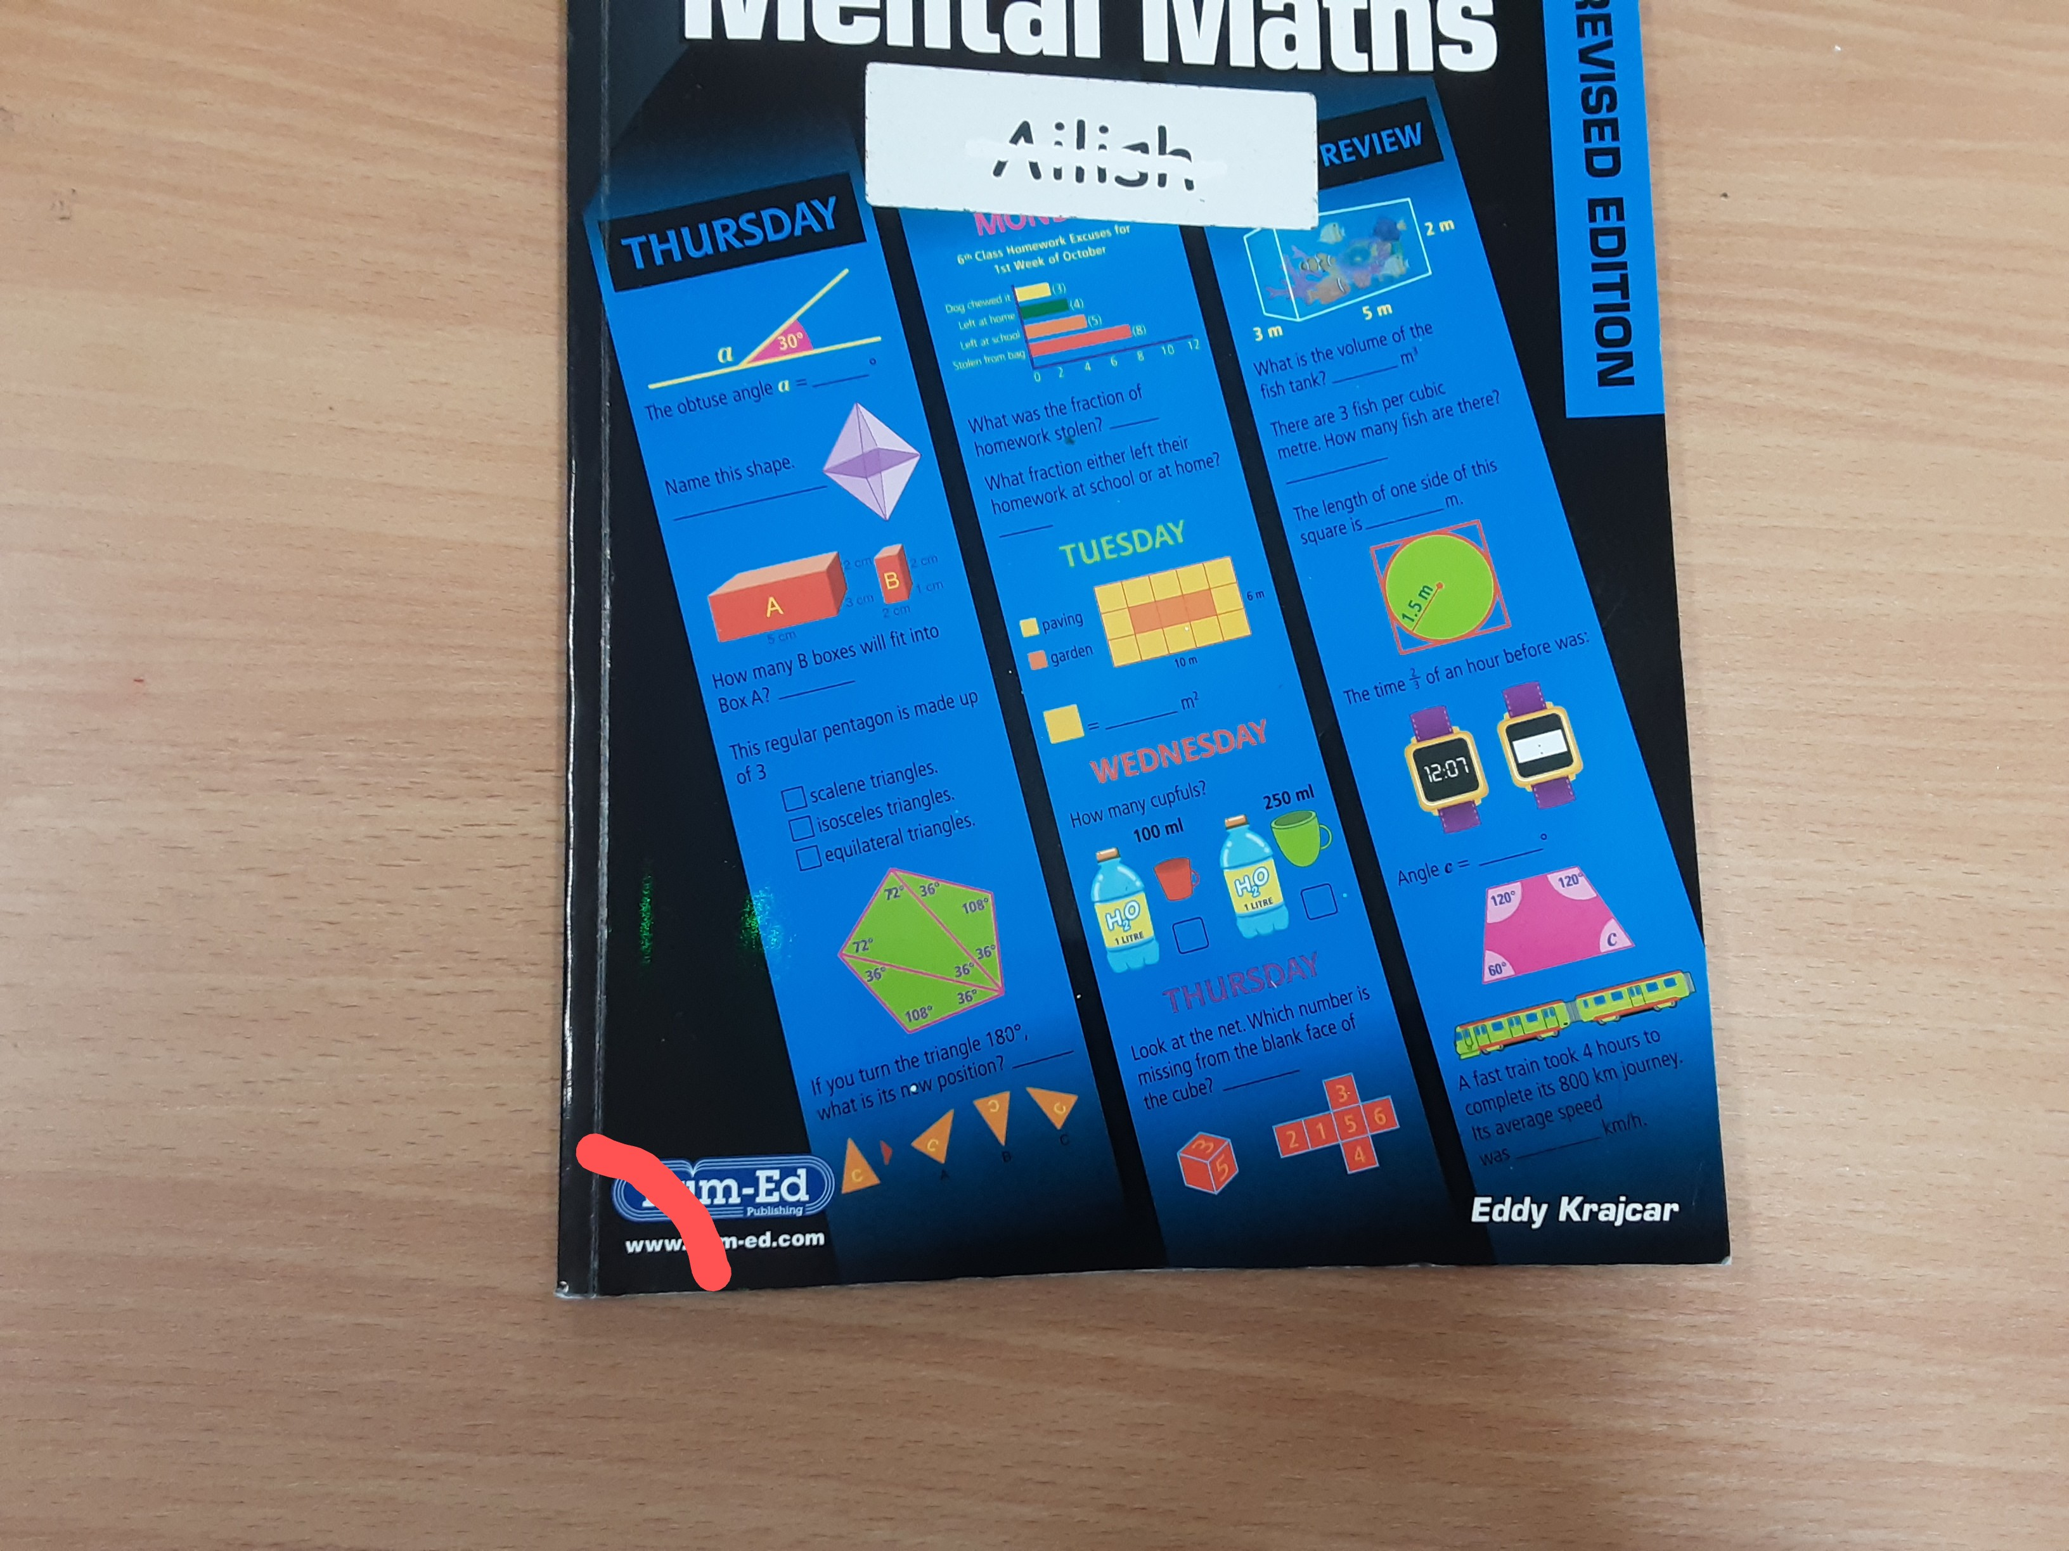
90° angles

Slide 3
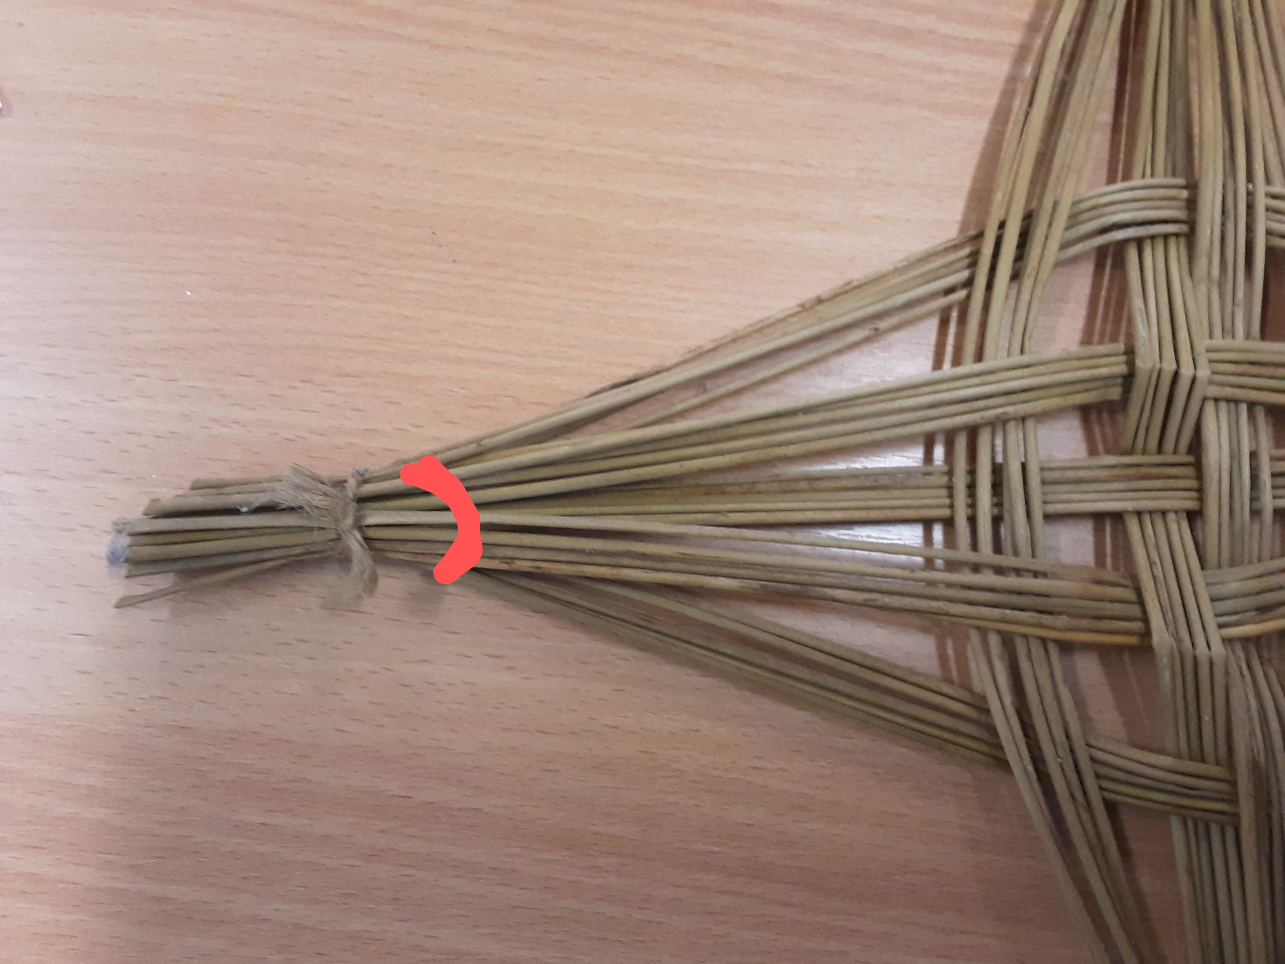
Acute angles

Slide 4
180° angles

Slide 5
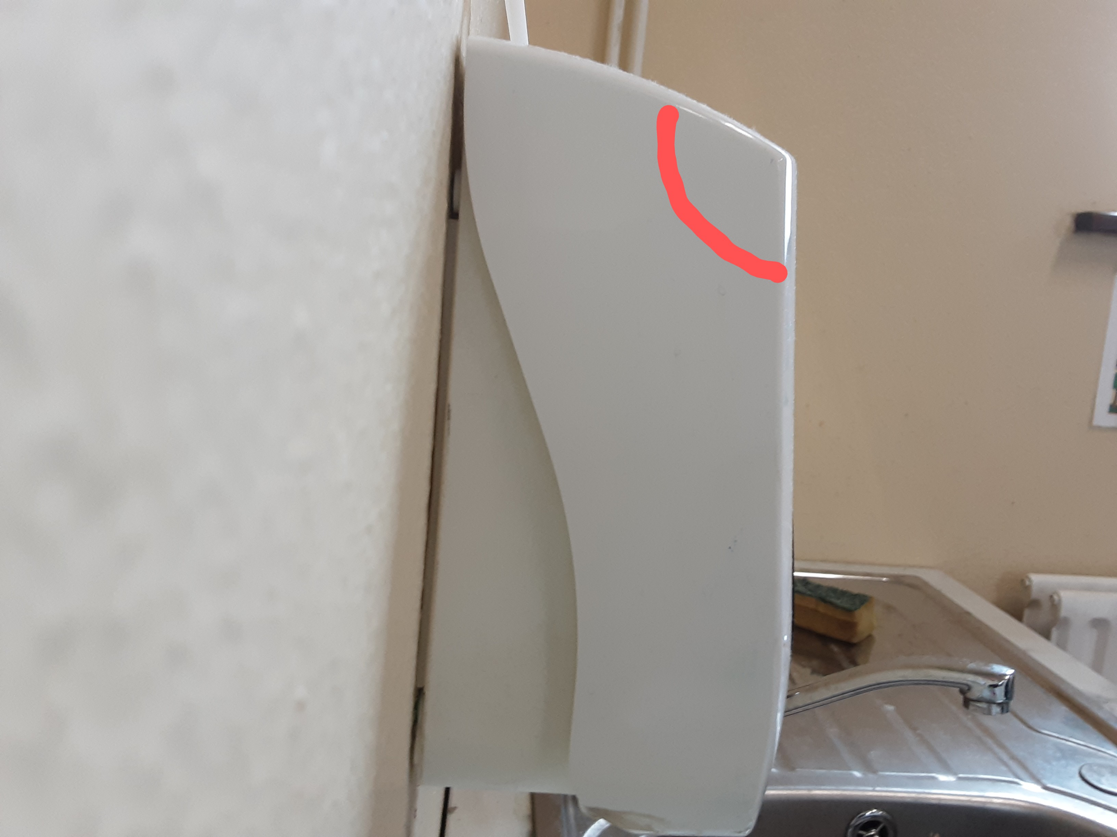
Obtuse angles

Slide 6
Full rotation (360°)

Slide 7
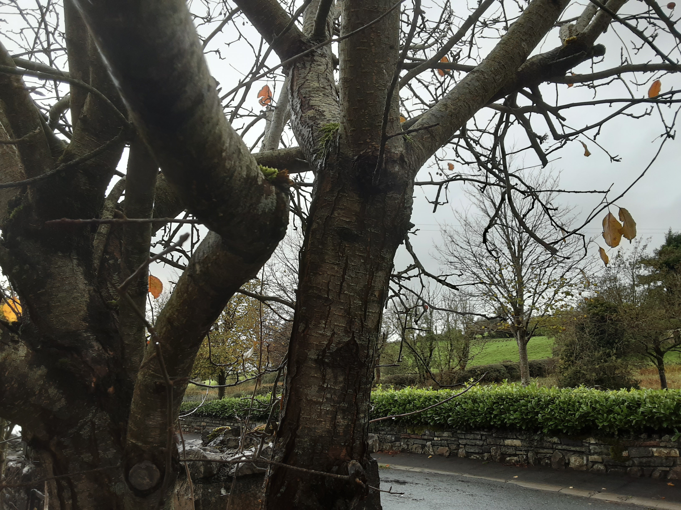
Reflex angles

Slide 8
270° angles

Slide 9
45° angle

Slide 10
Something with more than 3 different types of angles

Slide 11
An angle that can change

Slide 12
Thank you for listening!!!

